Slide 1

Optimising Llama2
Enhancing Efficiency and Scalability of Large Language Models with PyTorch
Chris Stylianou
Research Engineer
CaSToRC
eurocc.cyi.ac.cy
Notes:
Goals: Understanding key performance enhancements, Hands-on experience with optimized PyTorch code.

Slide 2



A Bit About Myself
Research Engineer at CaSToRC
Collaborations Task Leader for EuroCC2
Area of expertise in High Performance Computing (HPC)
PhD Candidate, EPCC
Contact & Info:
Email: c.stylianou@cyi.ac.cy
Website: cstyl.github.io

Slide 3
Introduction
Generative AI use cases have exploded in popularity recently!
Text generation one particularly popular area.
ChatGPT, Llama, vLLM etc.
PyTorch is a popular open-source ML/AI library widely used in the area of AI
Ease of Use and Flexibility
Strong community and industry support
Integration with Python ecosystem
Accelerated computing (GPU support)
Educational resources
How fast we can run transformer inference with only pure, native PyTorch?
Notes:
What is generative AI and why is it important?
Role of PyTorch in advancing AI research and application
How fast can we run transformer inference with only pure, native PyTorch?

Slide 4
Logistics
Training GitHub Repo to be available at:
https://github.com/CaSToRC-CyI/EuroCC2PyTorch
Complete tutorial:
https://github.com/pytorch-labs/gpt-fast
To download Llama2 7B parameters model, go to
https://huggingface.co/meta-llama/Llama-2-7b
Stored in HF Transformer format
Shared directory with processed weights available for the training!
Hardware to be used: A100 NVIDIA GPUs 40GB
Available are 5 nodes, with 4 GPUs each.
For accurate timings --exclusive access will be given for each run (i.e 5 users can run at the same time).

Slide 5
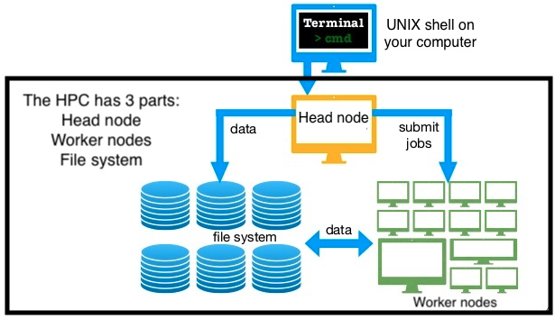
Environment Setup
# Connect to Cyclone
$ ssh <username>@front02.hpcf.cyi.ac.cy
# Project path containing code/data
$ export $PROJ_PATH=/nvme/scratch/edu20
# Checkpoints contain the Llama2 7B weights
$ ls $PROJ_PATH/gpt-fast
gpt-fast gpt-fast-checkpoints
# Make a local copy of the code
$ cp –R $PROJ_PATH/gpt-fast .
# Setup conda and activate environment
$ module load Anaconda/2023.03-1
$ conda init
$ conda activate $PROJ_PATH/envs/pytorch
# Code for the session
$ cd gpt-fast
Figure 1: High-level overview of a Supercomputer [1].

Slide 6
Establishing a Baseline
Llama2 (Meta) model
7B Parameters (~13GB)
BF16 Precision used for weights
Inference
Prompt: “Hello, my name is”
Generate 5 samples, up to 200 tokens.
Batch Size = 1
Resources configuration:
# of GPUs (Nodes): 1 (1)
CUDA Version: 11.8.0
PyTorch Version: 2.2
“Hello, my name is [Name], and I am a [insert activity or hobby here] enthusiast. I have been involved in this activity for [insert number of years] years, and I can tell you that it has brought me a great deal of joy and fulfillment.”
Original Model:
https://github.com/meta-llama/llama/tree/main

Slide 7
A Note on the Scheduler Settings
#!/bin/bash –l
#SBATCH --job-name=gpt-fast-baseline
#SBATCH --account=edu20
#SBATCH --nodes=1 # Request 1 Node
#SBATCH --ntasks-per-node=1 # Request 1 Process
#SBATCH --gpus=1 # Request 1 GPU
#SBATCH --cpus-per-task=12 # Request 12 threads (not used, but good for locality)
#SBATCH --partition=a100 # Request on Cluster with A100 NVIDIA GPUs
#SBATCH --time=01:00:00 # Request 1 process
#SBATCH --exclusive # Request exclusive access on whole node
#SBATCH --exclude=sim02
#SBATCH --output=%x-%j.out
# Setup paths
TRAINING_PATH=/nvme/scratch/edu20
CHECKPOINTS_PATH=$TRAINING_PATH/gpt-fast-checkpoints # Path to Weights
# Setup environment (Shared across all edu20)
module load Anaconda3/2023.03-1
module load CUDA/11.8.0
conda activate $TRAINING_PATH/envs/pytorch

Slide 8
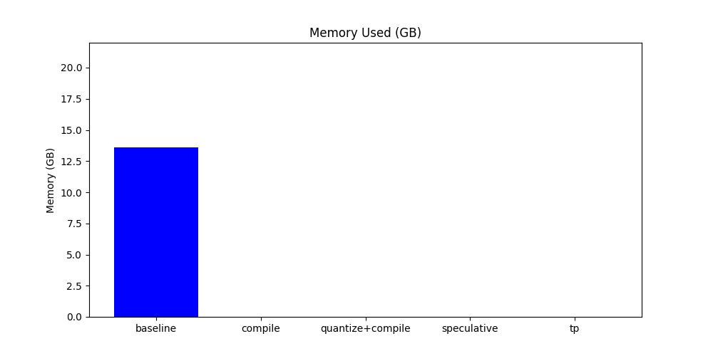
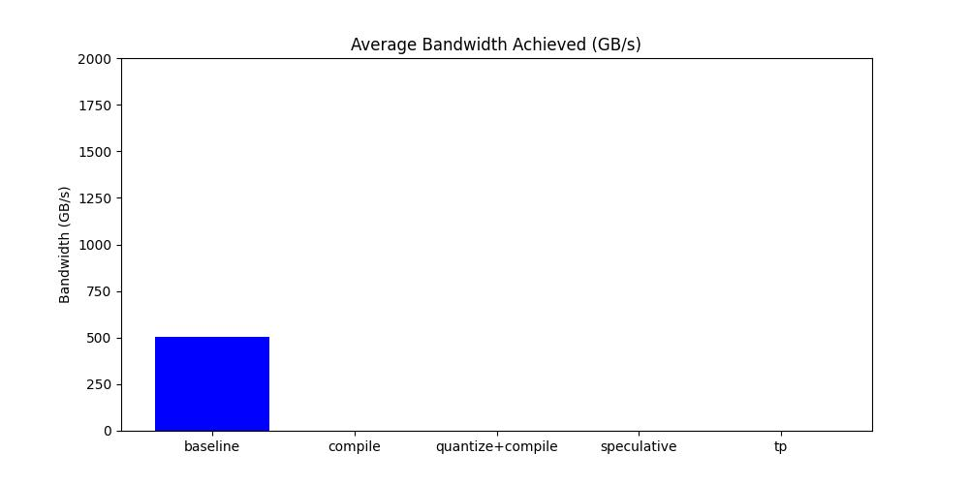
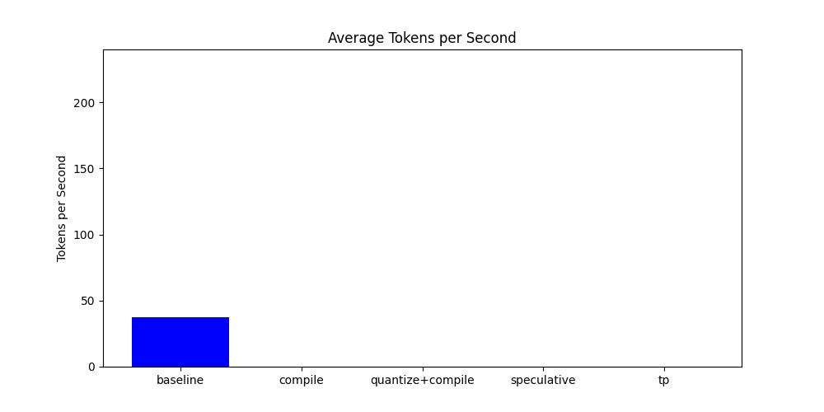
Running Baseline Version
# Go to Code Repository
$ cd $HOME/gpt-fast
$ sbatch scripts/run.baseline.slurm –reservation=edu20
Submitted batch job <JOBID>
# Check your job status
$ squeue --user=$USER
JOBID PARTITION NAME USER ST TIME …
<JOBID> a100 gpt-fast cstyl R 0:01 …
# Look for the output file
$ ls gpt-fast-baseline
gpt-fast-baseline-<JOBID>.out
# Plot the results
$ python plots/extract_and_plot.py gpt-fast-baseline- <JOBID>.out
Notes:
sbatch scripts/run.baseline.slurm –-reservation=edu20

Slide 9
The Problem with Baseline Model
Modern GPUs are extremely efficient, completing operations in microseconds
including tasks like kernel executions and memory transfers.
Despite their speed, the process of submitting these operations to the GPU introduces additional overhead.
Complex algorithms often require multiple GPU operations to complete a single task.
When GPU operations are sent individually and complete quickly, the combined overhead from each operation can lead to a noticeable drop in overall performance.
CPU acts as an orchestrator and tries to keep up with the overhead!
Solutions: Rewrite in C++, raw CUDA? Send more work to GPU at once?
Notes:
CUDA Graphs have been designed to allow work to be defined as graphs rather than single operations.

Slide 10
A Compiler for PyTorch Models
Purpose of torch.compile(): [Requires PyTorch >= 2.0]
Arbitrary Python functions can be optimised by passing the callable to torch.compile()
JIT Compilation, via minimal code changes.
Usage Example:
def foo(x, y):
a = torch.sin(x)
b = torch.cos(y)
return a + b
opt_foo1 = torch.compile(foo)
print(opt_foo1(torch.randn(10, 10), torch.randn(10, 10)))
Key Considerations:
Can also optimize torch.nn.Module
Compiles the optimised model/routine into optimised kernels as it executes
If structure of the model remains constant (i.e. no recompilation needed) overhead only paid once.
Useful if optimised model/routine is used several times.

Slide 11
A Compiler for PyTorch Models – LLM Case
Speedup achieved via reducing Python overhead and GPU read/writes.
torch.compile optimizes computational graphs in PyTorch to reduce CPU overhead.
Allows for larger model components to be compiled into a single optimized section.
Usage Example:
torch.compile(decode_one_token, mode="reduce-overhead", fullgraph=True)
Available Modes:
Default: For large models, low compile time, no extra memory
Reduce-overhead: Reduces framework overhead, uses extra memory, good for small models
Max-autotune: Produces the fastest model but takes a very long time to compile.
fullgraph=True :
Minimizes the frequency and impact of "graph breaks”
i.e portions that cannot be compiled.
Ensures maximum potential utilization of torch.compile .
Notes:
Modern GPUs are so fast that, in many cases of interest, the time taken by each GPU operation (e.g. kernel or memory copy) is now measured in microseconds.
However, there are overheads associated with the submission of each operation to the GPU.
Typically, multiple algorithmic stages corresponding to multiple GPU operations are required per timestep.
If each of these operations is launched to the GPU separately, and completes quickly, then overheads can combine to form a significant overall degradation to performance.
CUDA Graphs have been designed to allow work to be defined as graphs rather than single operations.
decode_one_token (inference function)
-> logits = model(x, input_pos)

Slide 12
A Compiler for PyTorch Models – KV Caching
A common optimisation trick for speeding up transformer inference.
Activations computed for the previous tokens are cached.
As more tokens are generated, the “logical length” of the kv-cache grows.
Rellocating and copying every time the cache grows!
Due to this dynamism torch.compile less efficient
i.e. need to recompile.
Use “static” kv-cache:
Statically allocate the maximum size of kv-cache
Mask out the unused values in the attention portion
with torch.device(device):
model.setup_caches(max_batch_size=1, max_seq_length=max_seq_lenght)
Two-phase compilation:
The prefill, where the entire prompt is processed
more dynamic, due to variable promtp length
prefill = torch.compile(prefill, dynamic=True, fullgraph=True)
Decoding, where each token is generated (kv-cache static)
decode_one_token = torch.compile(decode_one_token,
mode="reduce-overhead", fullgraph=True)

Slide 13
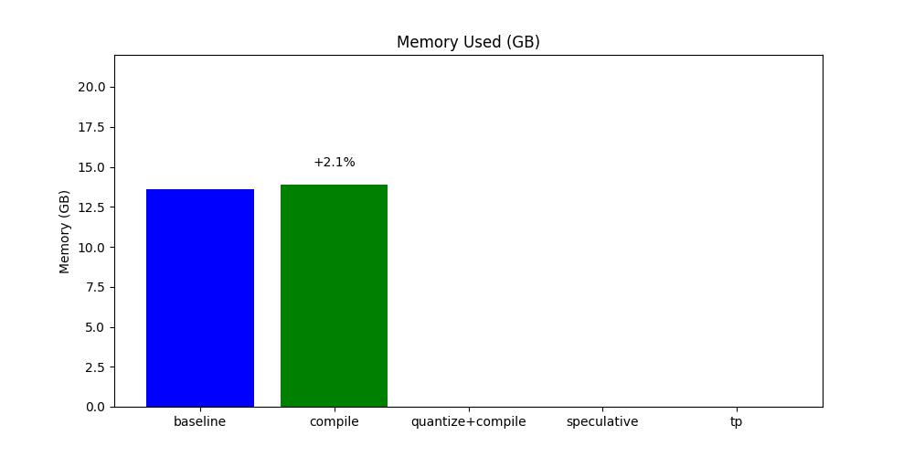
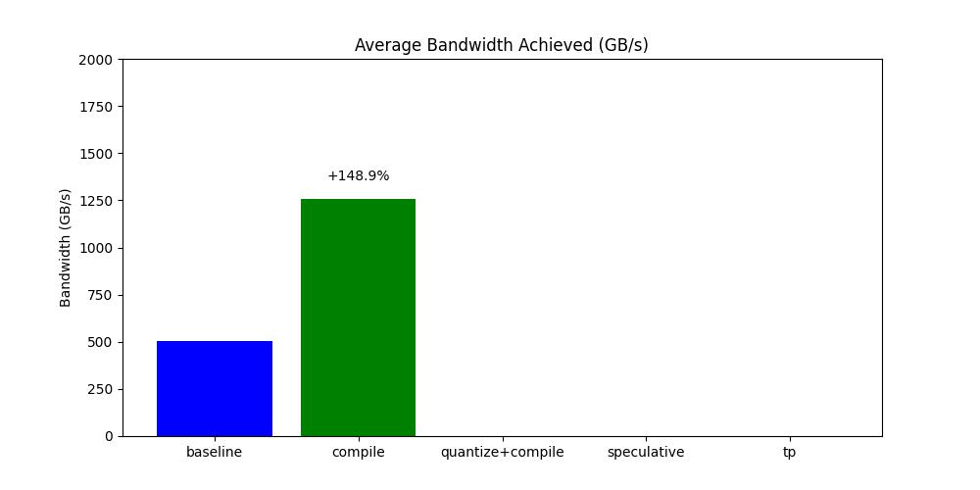
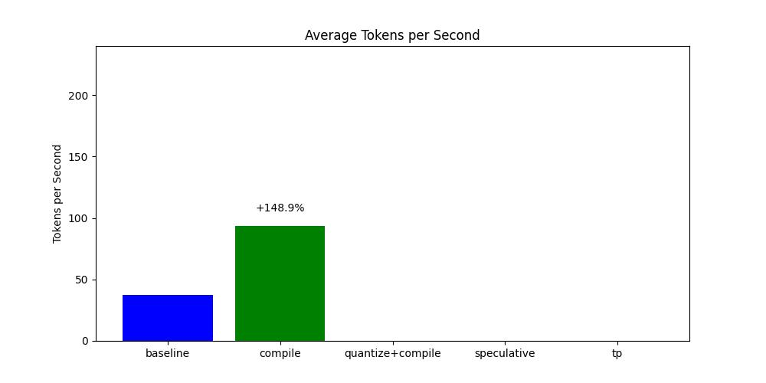
Running Compile Version
# Go to Code Repository
$ cd $HOME/gpt-fast
$ sbatch scripts/run.compile.slurm
Submitted batch job <JOBID>
# Check your job status
$ squeue --user=$USER
JOBID PARTITION NAME USER ST TIME …
<JOBID> a100 gpt-fast cstyl R 0:01 …
# Look for the output file
$ ls gpt-fast-compile
gpt-fast-compile-<JOBID>.out
# Plot the results
$ python plots/extract_and_plot.py gpt-fast-baseline-488363.out gpt-fast-compile-<JOBID>.out
Notes:
There’s 2 main factors leading to torch.compile’s performance:
Overhead reduction, with the most effective one called CUDAGraphs
Applied automatically when ”reduce-overhead” used, no extra work to rewrite your code
Generates faster kernels
Transformer decoding has very unusual computational properties
Because of the KV-cache, for BS=1 every single matrix multiplication becomes matrix vector!
Computation now becomes memory bandwidth bounded!

Slide 14
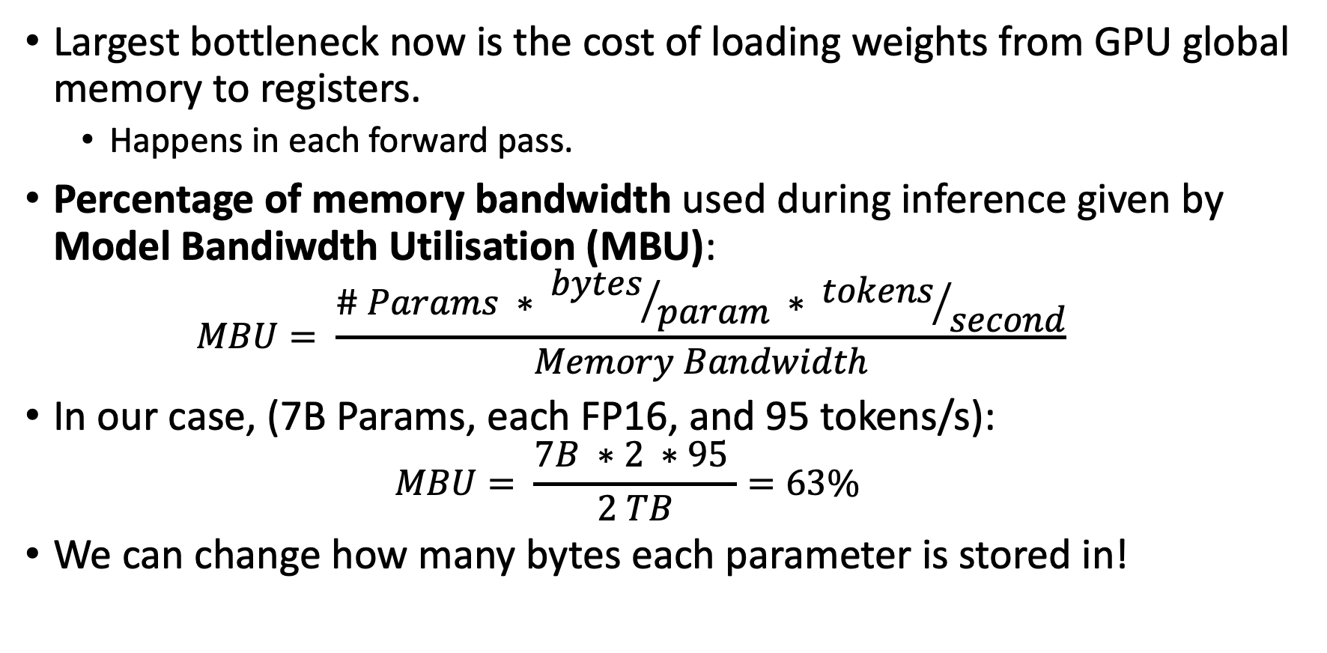
Accelerating Models with Reduced Precision Operations
Largest bottleneck now is the cost of loading weights from GPU global memory to registers.
Happens in each forward pass.
Percentage of memory bandwidth used during inference given by Model Bandiwdth Utilisation (MBU):
$$MBU= \frac{\# Params ∗ {bytes}/{param} ∗ {tokens}/{second}}{Memory Bandwidth}$$
In our case, (7B Params, each FP16, and 95 tokens/s):
$$MBU= \frac{7B ∗2 ∗95 }{2 TB}=63\%$$
We can change how many bytes each parameter is stored in!
Notes:
We simply take the total size of our model (# params * bytes per param) and multiply it by the number of inferences we can do per second
Then, we divide this by the peak bandwidth of the GPU to get our MBU.
63% quite good, considering that even just copying memory struggles to break 85%.

Slide 15
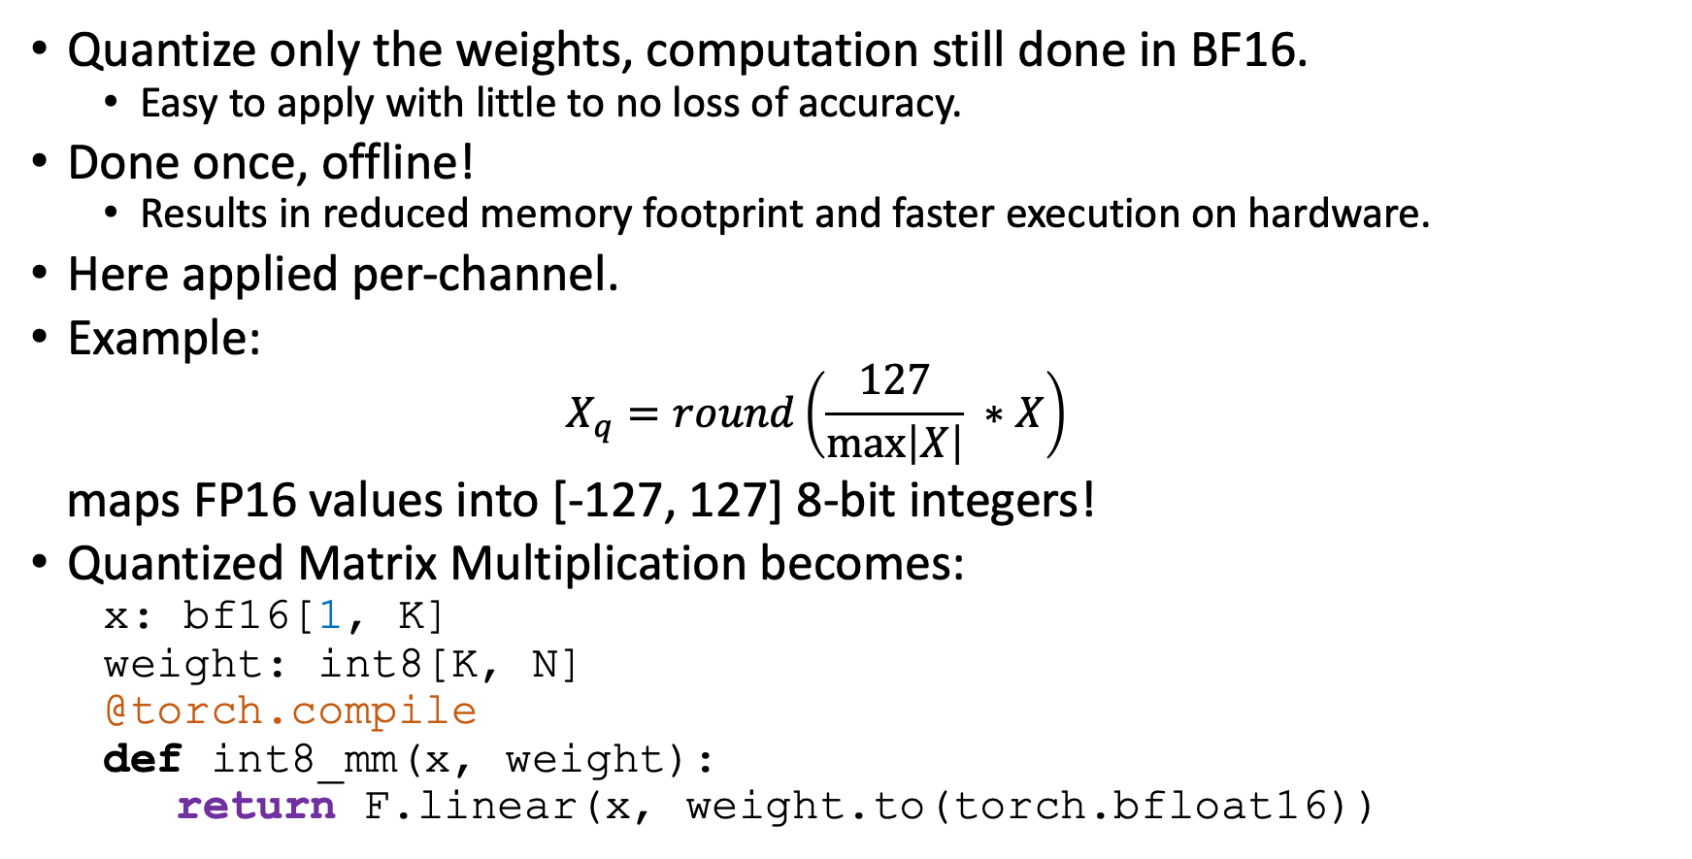
Accelerating Models with Reduced Precision – From BF16 to INT8
Quantize only the weights, computation still done in BF16.
Easy to apply with little to no loss of accuracy.
Done once, offline!
Results in reduced memory footprint and faster execution on hardware.
Here applied per-channel.
Example:
$$X_{q}=round\left(\frac{127}{\max\left|X\right|} ∗X\right)$$
maps FP16 values into [-127, 127] 8-bit integers!
Quantized Matrix Multiplication becomes:
x: bf16[1, K]
weight: int8[K, N]
@torch.compile
def int8_mm(x, weight):
return F.linear(x, weight.to(torch.bfloat16))

Slide 16
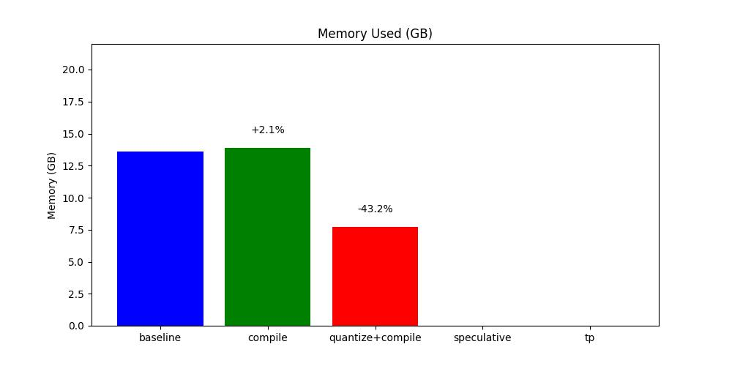
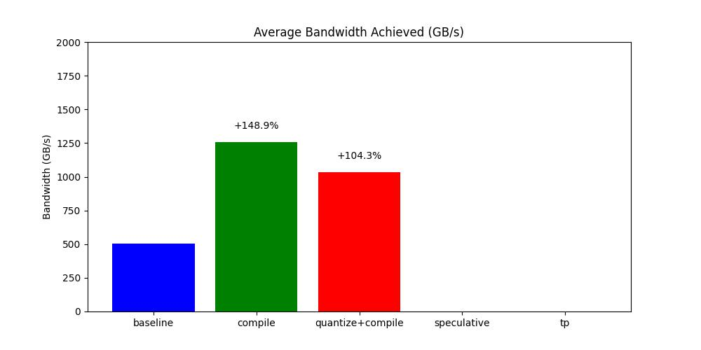
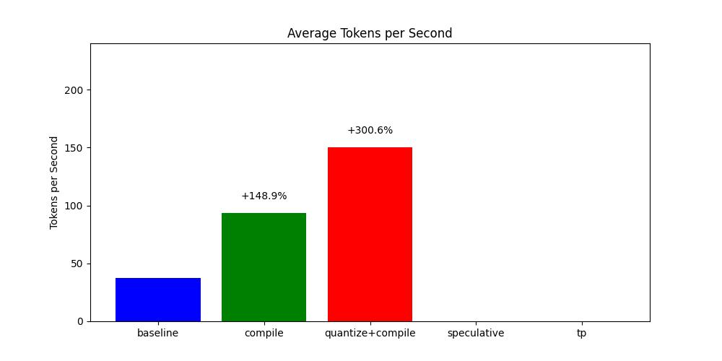
Running Quantized Version
# Go to Code Repository
$ cd $HOME/gpt-fast
$ sbatch scripts/run.quantize.slurm
Submitted batch job <JOBID>
# Check your job status
$ squeue --user=$USER
JOBID PARTITION NAME USER ST TIME …
<JOBID> a100 gpt-fast cstyl R 0:01 …
# Look for the output file
$ ls gpt-fast-quantize
gpt-fast-quantize-<JOBID>.out
# Plot the results
$ python plots/extract_and_plot.py gpt-fast-baseline-488363.out gpt-fast-compile-488364.out gpt-fast-quantize-<JOBID>.out

Slide 17
Speculative Decoding
For every token generated, weights have to be loaded over and over.
Strict serial dependency in autoregressive generation.
Speculative decoding breaks this dependency!
Main Idea:
Larger model, which we want to use for inference (Verifier Model)
Smaller model, able to generate text much faster (Draft Model)
But more inaccurate!
Generate N tokens using the cheaper draft model, then process all of them in parallel using the verifier model
Those not matching, discard and regenerate with Verifier Model.
Speculative decoding does not change the quality of the output.
Around 50 lines of code implementation.
Runtime performance varies depending on the generated text.

Slide 18
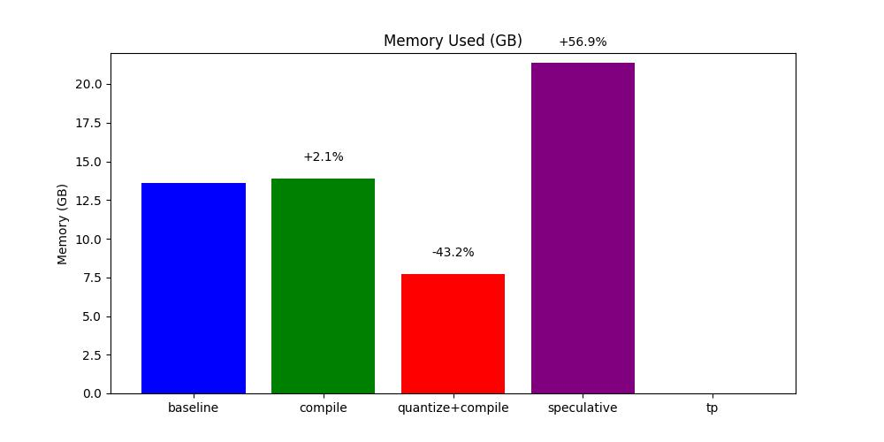
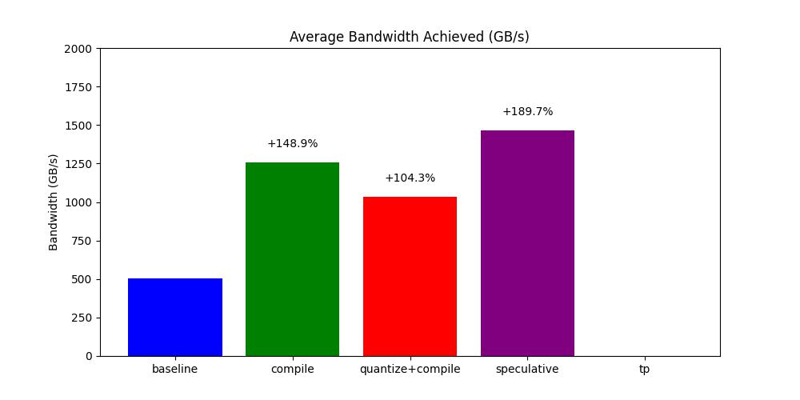
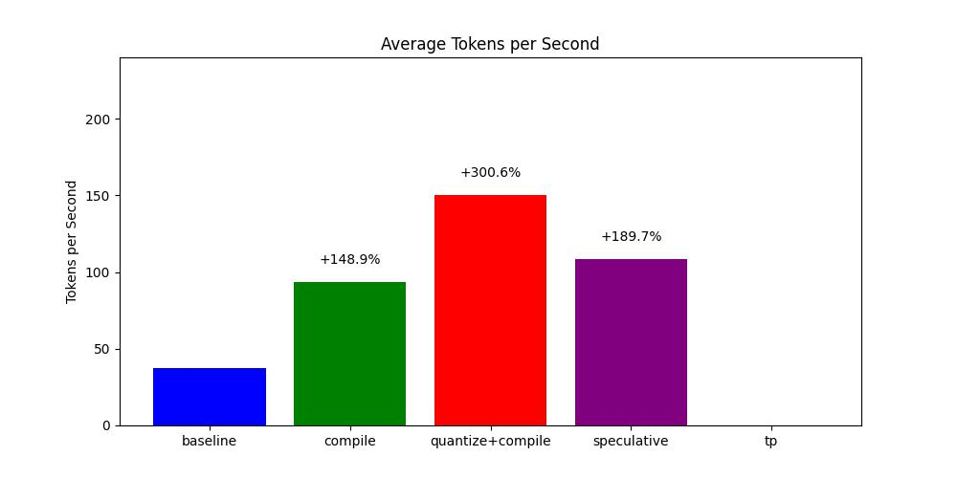
Running Speculative Version
# Go to Code Repository
$ cd $HOME/gpt-fast
$ sbatch scripts/run.speculative.slurm
Submitted batch job <JOBID>
# Check your job status
$ squeue --user=$USER
JOBID PARTITION NAME USER ST TIME …
<JOBID> a100 gpt-fast cstyl R 0:01 …
# Look for the output file
$ ls gpt-fast-speculative
gpt-fast-speculative-<JOBID>.out
# Plot the results
$ python plots/extract_and_plot.py gpt-fast-baseline-488363.out gpt-fast-compile-488364.out gpt-fast-quantize-488365.out gpt-fast-speculative-<JOBID>.out

Slide 19
Tensor Parallelism
So far, only one GPU was used!
Running on more GPUs gives us access to more memory bandwidth.
Parallelisation strategy is to split the processing of one token across multiple devices
Tensor Parallelism
PyTorch supports this, although low-level API currently.
150 lines of code, no model changes!
Main idea:
def forward(self, x: torch.Tensor) -> torch.Tensor:
x = F.silu(self.c_fc1(x)) * self.c_fc2(x)
x = self.c_proj(x)
x = collectives.all_reduce(x, “sum”, list(range(LOCAL_WORLD_SIZE)))
return x

Slide 20
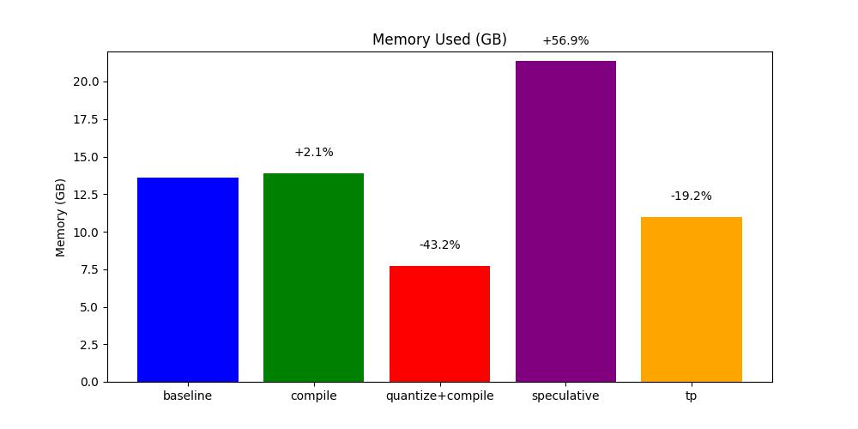
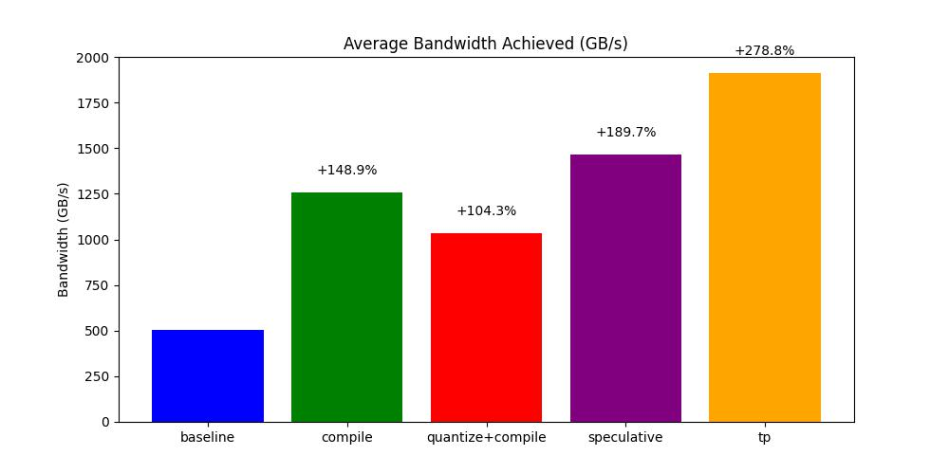
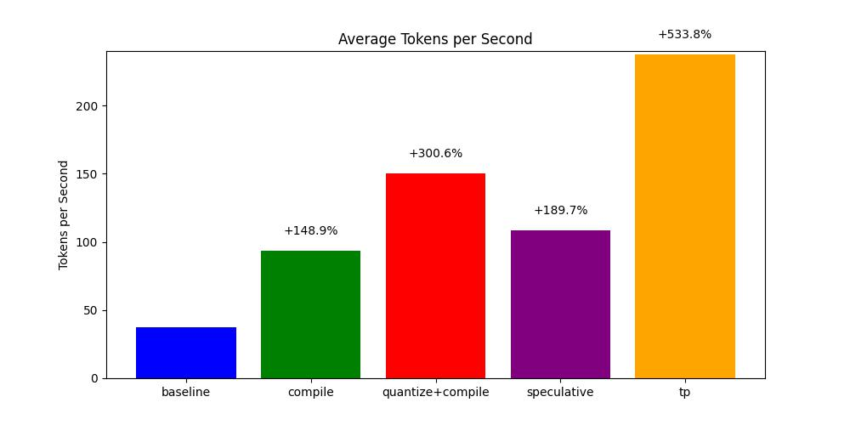
Running Tensor Parallelism Version
# Go to Code Repository
$ cd $HOME/gpt-fast
$ sbatch scripts/run.tp.slurm
Submitted batch job <JOBID>
# Check your job status
$ squeue --user=$USER
JOBID PARTITION NAME USER ST TIME …
<JOBID> a100 gpt-fast cstyl R 0:01 …
# Look for the output file
$ ls gpt-fast-tp
gpt-fast-tp-<JOBID>.out
# Plot the results
$ python plots/extract_and_plot.py gpt-fast-baseline-488363.out gpt-fast-compile-488364.out gpt-fast-quantize-488365.out gpt-fast-speculative-488366.out gpt-fast-tp-488367.out

Slide 21
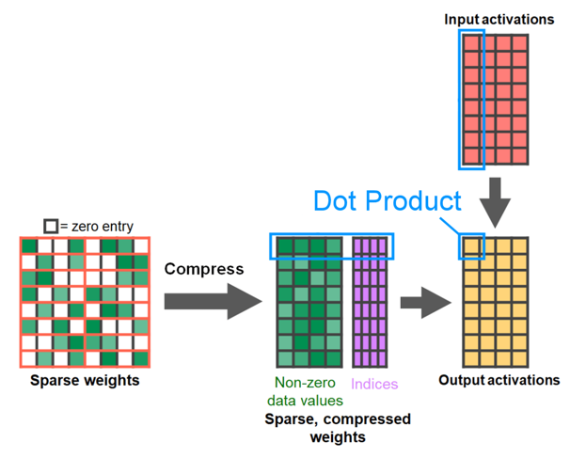
Other Optimisations
Memory efficient attention implementations
Scaled dot product attention (SPDA)
Semi-structured (2:4) Sparsity
Good for Sparsification/Prunning
From developer.nvidia.com/blog/exploiting-ampere-structured-sparsity-with-cusparselt

Slide 22
Summary
Using native PyTorch offers ease of use without sacrificing performance.
The code for optimisations is around 900 lines.
torch.compile
Quantization (BF16 to INT8)
Speculative Decoding (Expert 7B 16BF, Draft 7B INT8)
Tensor Parallelism
From:
37 tokens/second to 237!
1 GPU to multiple.
Overhead-bound to memory bandwidth bound.

Slide 23


Acknowledgements
This project has received funding from the European High-Performance Computing Joint Undertaking (JU) under grant agreement No 101101903.
The hands-on sessions have been carried out on the SimEA Partition on Cyclone HPC system at The Cyprus Institute, funded by European Union’s Horizon 2020 research and innovation program (grant agreement no. 810660, SimEA).

Slide 24
References
https://gu-eresearch.github.io/hpcWorkshop/content/12-logOntoHPC.html

